Slide 1
Classic ML
Deep Learning and Image Processing

Slide 2




MACHINE LEARNING
no supervision, but goal-based interaction with environment
training target available (labeled or past data)
data not labeled in any way
SUPERVISED
REINFORCEMENT LEARNING
UNSUPERVISED
CLASSIFICATION
ASSOCIATION
CLUSTERING
LEARN STATE OR ACTION VALUES
LEARN POLICY DIRECTLY
REGRESSION
DIMENSIONALITY REDUCTION
SELF-SUPERVISED
learning by teacher
(high-dimensional curve fitting)
learning by observation
(pattern recognition)
learning by trial-and-error
(sequential decision making)
unsupervised and reinforcement learning can both be cast as supervised-learning setup

Slide 3

Supervised Learning
Target Quantity
Features
known in training: labeled samples or observations from past
to be predicted for unknown cases (e.g., future values)
(prepared) input information that is
correlated to target quantity
known at prediction time
features x1 and x2 spam, no spam
decision boundary
Example: Spam Filtering
classify emails as spam or no spam
use information like occurrence of specific words or email length as features
use accordingly labeled emails as training set

Slide 4
Optimization

Slide 5
General Recipe of Statistical Learning
ML algorithm by combining:
model (e.g., linear function & Gaussian distribution)
objective function (e.g., squared residuals)
optimization algorithm (e.g., gradient descent)
regularization (e.g., L2, dropout)

Slide 6
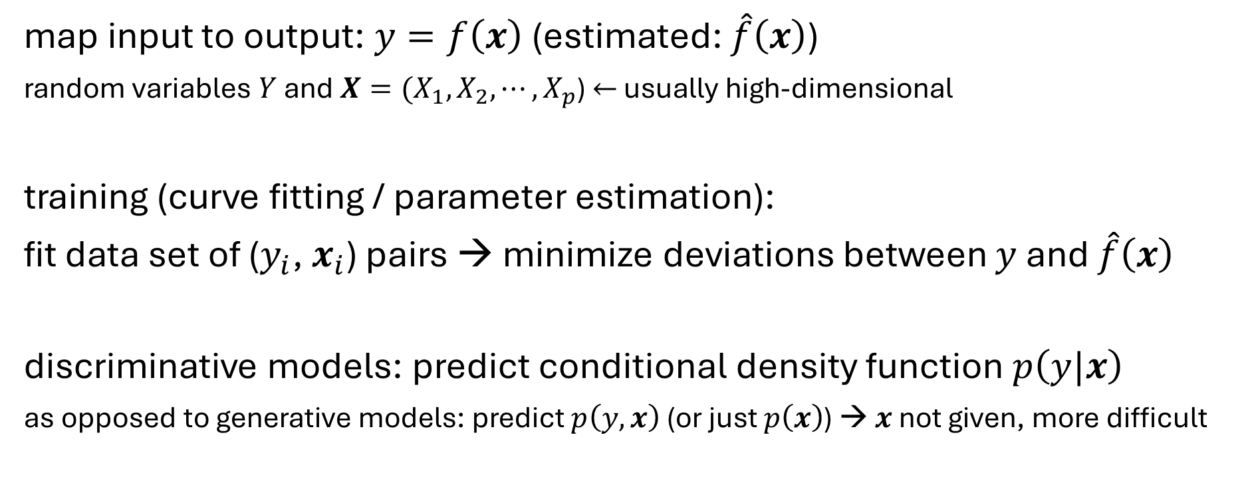
Supervised Learning in Mathematical Terms
map input to output: $y=f\left(x\right)$ (estimated: $\hat{f}\left(x\right)$)
random variables $Y$ and $X={(X}_{1}, X_{2},{⋯,X}_{p}$) $←$ usually high-dimensional
training (curve fitting / parameter estimation):
fit data set of ($y_{i}$, $x_{i}$) pairs → minimize deviations between $y$ and $\hat{f}\left(x\right)$
discriminative models: predict conditional density function $p\left(y|x\right)$
as opposed to generative models: predict $p\left(y, x\right)$ (or just $p\left(x\right)$) → $x$ not given, more difficult

Slide 7
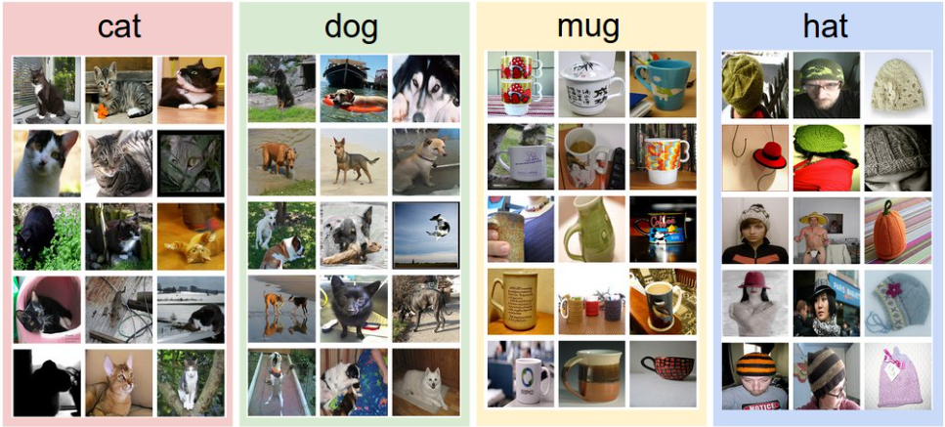
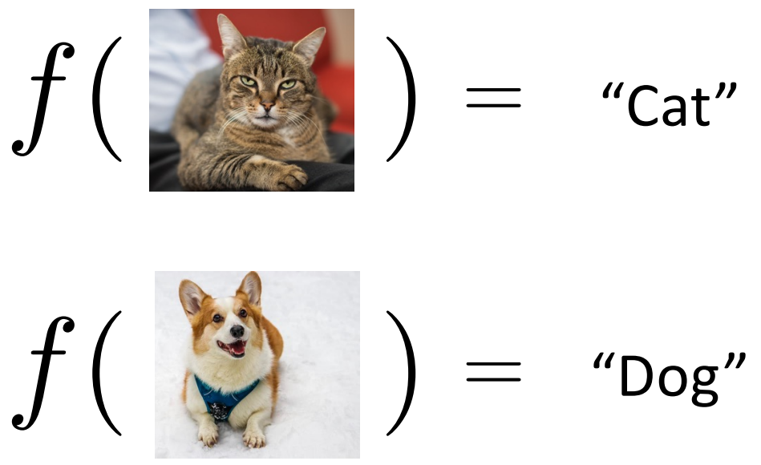
Example: Image Classification
training data set:
test data with learned classifier:
labels:

Slide 8

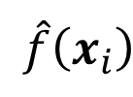
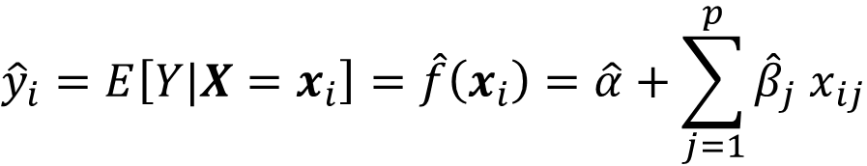
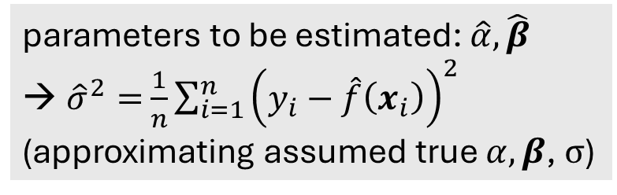
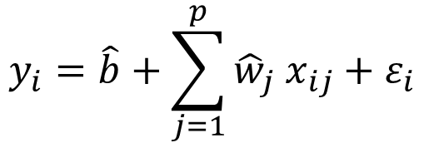
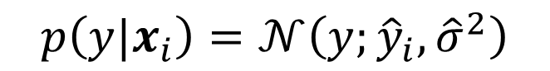
Linear Regression
$$\hat{f}\left(x_{i}\right)$$
fit:
$$y_{i}=\hat{b}+\sum_{j=1}^{p}{{\hat{w}}_{j} x_{ij}}+ε_{i}$$
parameter estimation:
e.g., least squares
Gaussian
predict:
$${\hat{y}}_{i}=E\left[Y|X=x_{i}\right]=\hat{f}\left(x_{i}\right)=\hat{α}+\sum_{j=1}^{p}{{\hat{β}}_{j} x_{ij}}$$
parameters to be estimated: $\hat{α},\hat{β}$
${\hat{σ}}^{2}=$ $\frac{1}{n}\sum_{i=1}^{n}{{\left(y_{i}−\hat{f}\left(x_{i}\right)\right)}^{2}}$
(approximating assumed true $α, β$, $σ$)
$$p\left(y|x_{i}\right)=𝒩\left(y;{\hat{y}}_{i}, {\hat{σ}}^{2}\right)$$
Gaussian
mean
variance

Slide 9
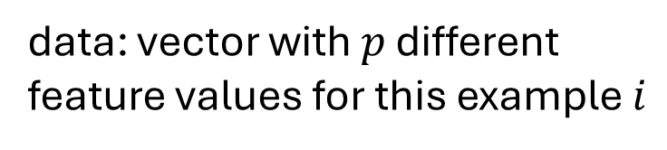
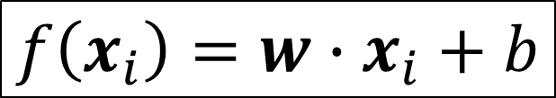
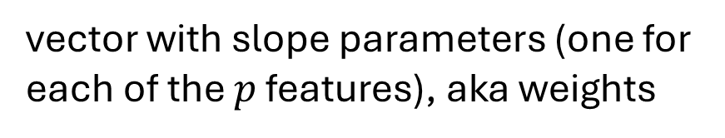
Brief Notation
data: vector with $p$ different feature values for this example $i$
$$f\left(x_{i}\right)=w∙x_{i}+b$$
vector with slope parameters (one for each of the $p$ features), aka weights
intercept parameter, aka bias
for simplicity of notation, dropping the hats of estimated parameters from now on

Slide 10
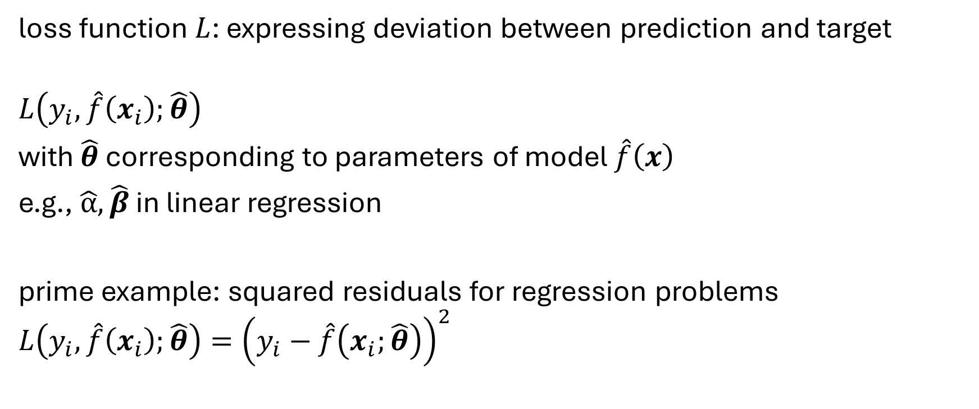
Loss Function
loss function $L$: expressing deviation between prediction and target
$$L\left(y_{i},\hat{f}\left(x_{i}\right);\hat{θ}\right)$$
with $\hat{θ}$ corresponding to parameters of model $\hat{f}\left(x\right)$
e.g., $\hat{α}, \hat{β}$ in linear regression
prime example: squared residuals for regression problems
$$L\left(y_{i},\hat{f}\left(x_{i}\right);\hat{θ}\right)={\left(y_{i}−\hat{f}\left(x_{i};\hat{θ}\right)\right)}^{2}$$

Slide 11
Cost Function
averaging losses over (empirical) training data set:
$$J\left(\hat{θ}\right)=\frac{1}{n}\sum_{i=1}^{n}{L\left(y_{i},\hat{f}\left(x_{i}\right);\hat{θ}\right)}$$
cost function to be minimized according to model parameters $\hat{θ}$
→ objective function

Slide 12
Cost Minimization
minimize training costs $J\left(\hat{θ}\right)$ according to model parameters $\hat{θ}$:
$∇_{\hat{θ}} J\left(\hat{θ}\right)=0$
for mean squared error (aka least squares method):
$∇_{\hat{θ}} \frac{1}{n}\sum_{i=1}^{n}{{\left(y_{i}−\hat{f}\left(x_{i};\hat{θ}\right)\right)}^{2}}=0$

Slide 13
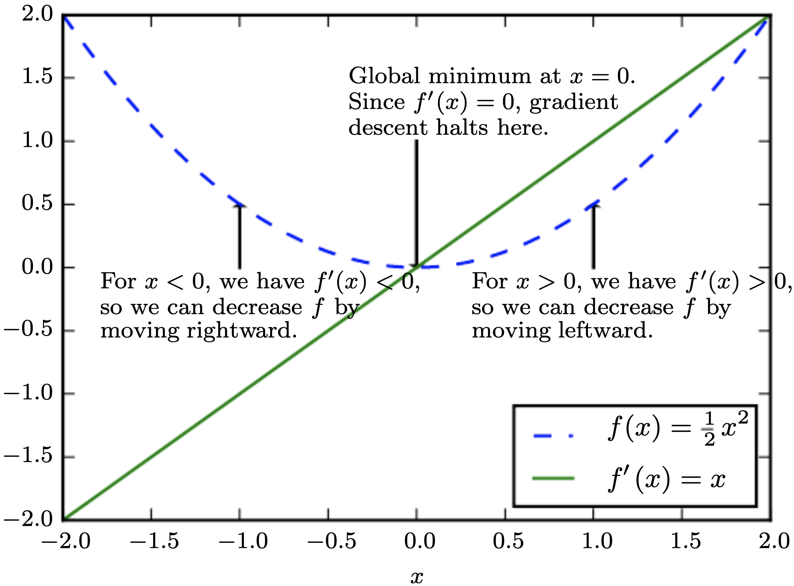

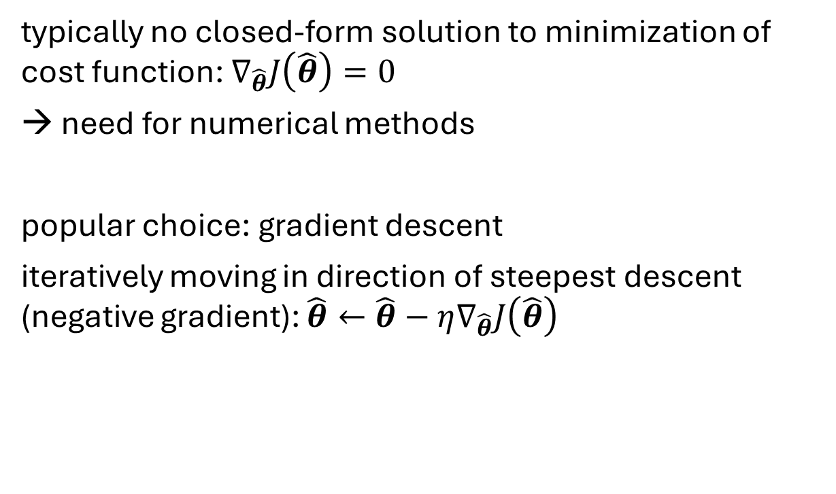
Gradient Descent
typically no closed-form solution to minimization of cost function: $∇_{\hat{θ}}J\left(\hat{θ}\right)=0$
need for numerical methods
popular choice: gradient descent
iteratively moving in direction of steepest descent (negative gradient): $\hat{θ}←\hat{θ}−η∇_{\hat{θ}}J\left(\hat{θ}\right)$
source
local minimum
global minimum
step size (learning rate)
vector containing all partial derivatives

Slide 14
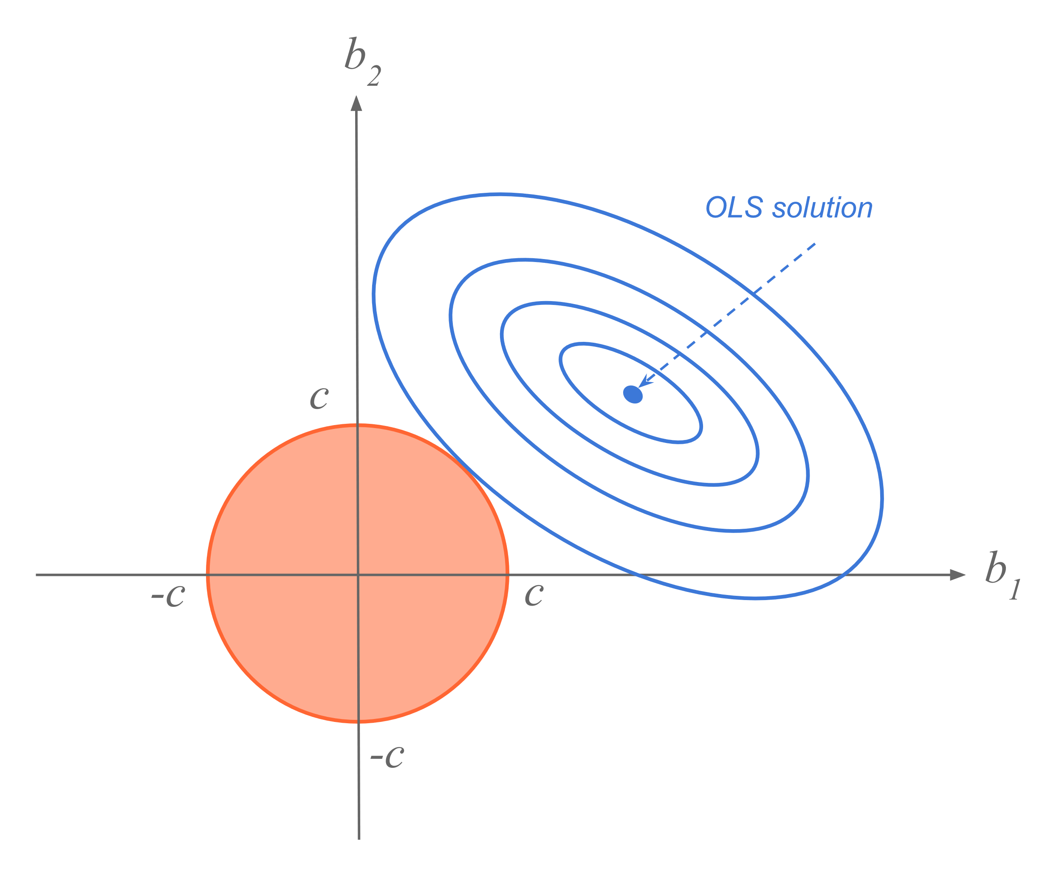
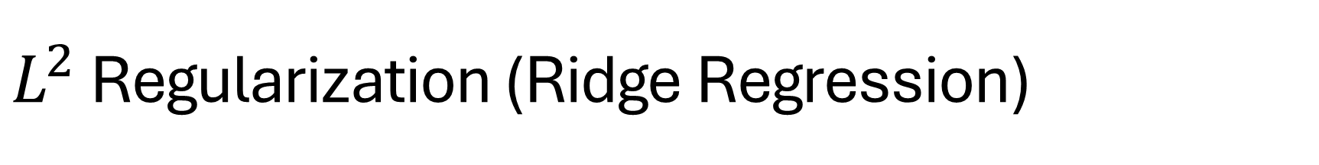
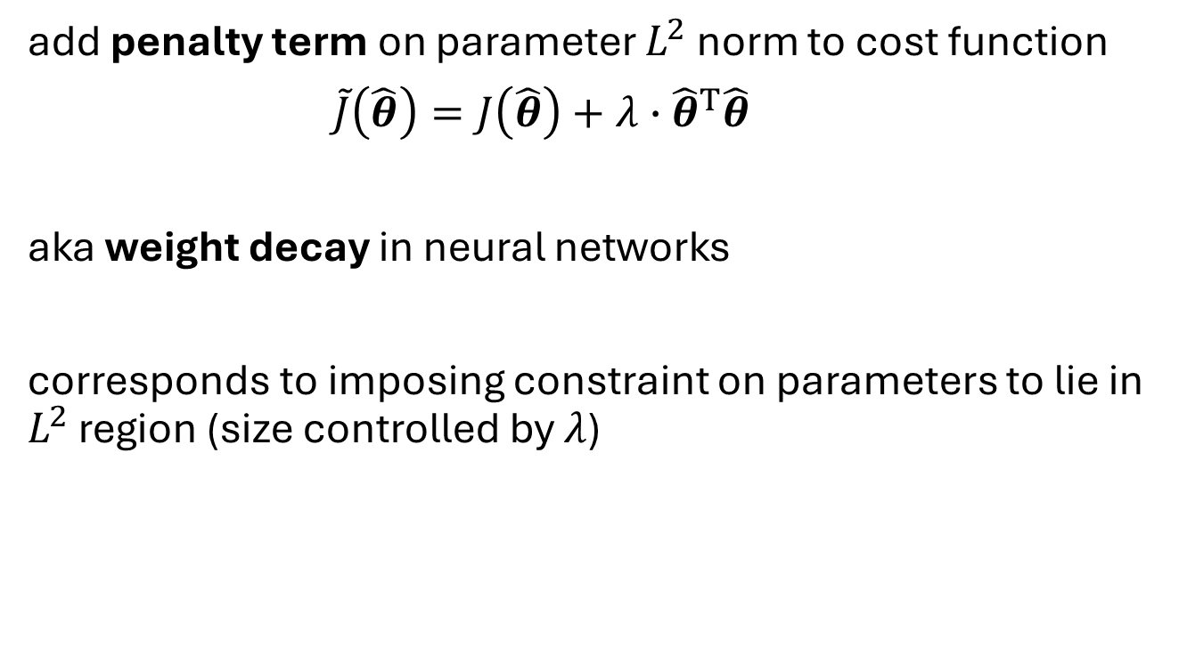
$L^{2}$ Regularization (Ridge Regression)
add penalty term on parameter $L^{2}$norm to cost function
$\tilde{J}\left(\hat{θ}\right)=J\left(\hat{θ}\right)+λ∙{\hat{θ}}^{T}\hat{θ}$
aka weight decay in neural networks
corresponds to imposing constraint on parameters to lie in $L^{2}$ region (size controlled by $λ$)
hyperparameter controlling strength of regularization
source

Slide 15
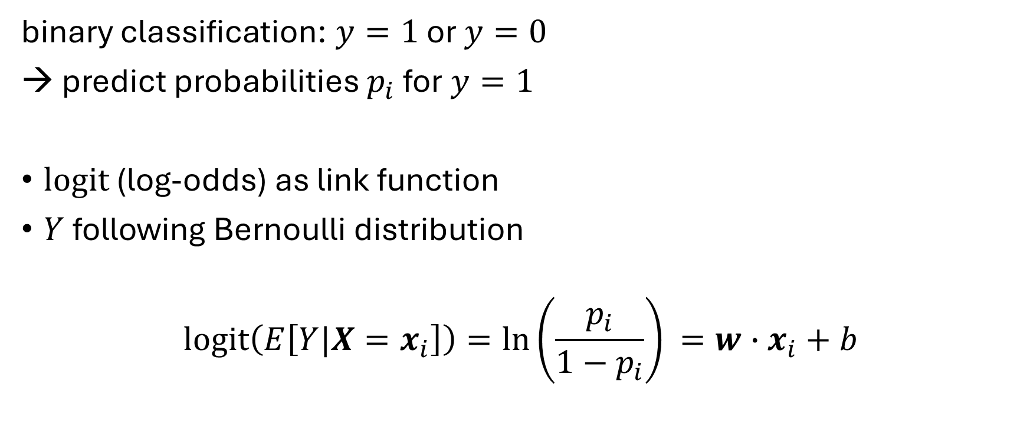
Classification: Logistic Regression
binary classification: $y=1$ or $y=0$
→ predict probabilities $p_{i}$ for $y=1$
logit (log-odds) as link function
$Y$ following Bernoulli distribution
$$\operatorname{logit}\left(E\left[Y|X=x_{i}\right]\right)=\ln\left(\frac{p_{i}}{1−p_{i}}\right)⁡=w∙x_{i}+b$$

Slide 16
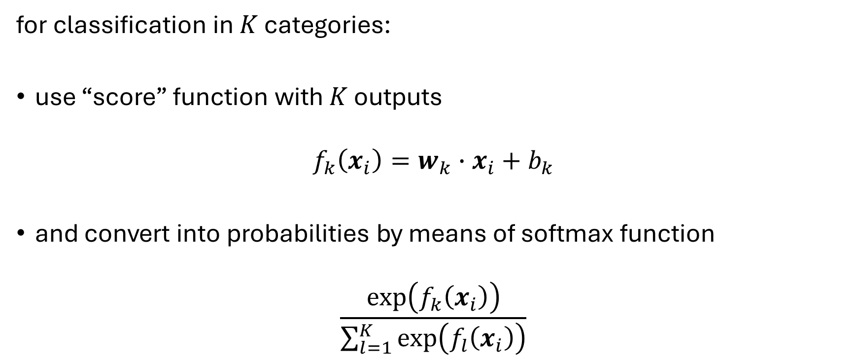
Multi-Classification: Softmax
for classification in $K$ categories:
use “score” function with $K$ outputs
$$f_{k}\left(x_{i}\right)=w_{k}∙x_{i}+b_{k}$$
and convert into probabilities by means of softmax function
$$\frac{\exp\left(f_{k}\left(x_{i}\right)\right)}{\sum_{l=1}^{K}{\exp\left(f_{l}\left(x_{i}\right)\right)}}$$

Slide 17
Need for Generalization

Slide 18

Under- and Over-Fitting
example: polynomial fit
need to predict new samples (not in training data set): interpolation
degree of fitted polynomial

Slide 19


Bias, Variance, Irreducible Error
think of fitting ML algorithms as repeatable processes with different data sets
irreducible error (aka Bayes error):
inherent randomness (target generated from random variable)
limiting accuracy of ideal model
bias
due to too simplistic model (same for all training data sets)
“underfitting”
variance
due to sensitivity to specifics (noise) of different training data sets
“overfitting”

Slide 20

Bias-Variance Tradeoff
models of higher complexity have lower bias but higher variance
(given the same number of training examples)
generalization error follows U-shaped curve: overfitting once model complexity (number of parameters) passes certain threshold
overfitting: variance term dominating test error
→ increasing model complexity increases test error
but beware: training error keeps decreasing with more complex model …

Slide 21
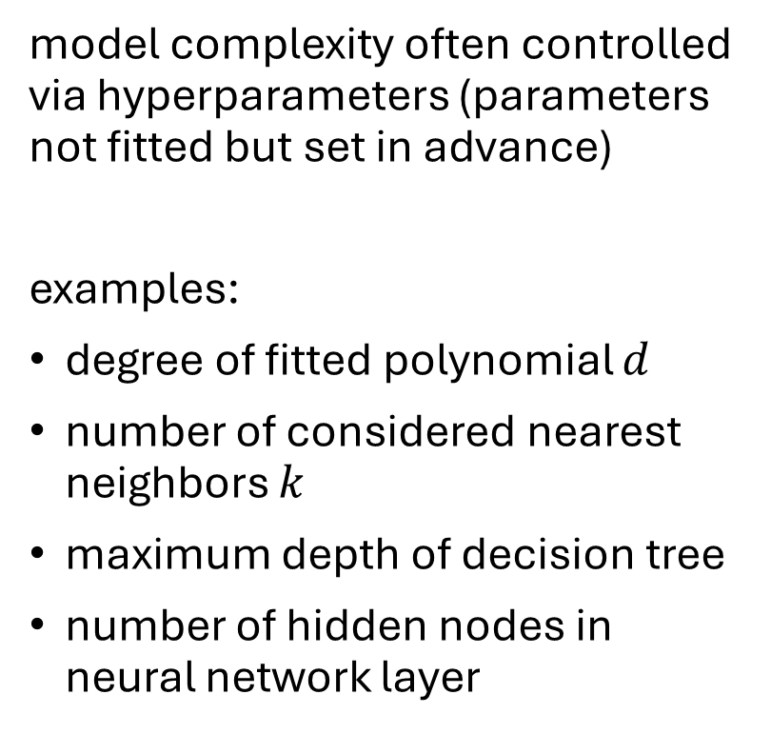
Hyperparameters
model complexity often controlled via hyperparameters (parameters not fitted but set in advance)
examples:
degree of fitted polynomial $d$
number of considered nearest neighbors $k$
maximum depth of decision tree
number of hidden nodes in neural network layer
hyperparameter tuning

Slide 22
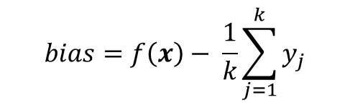
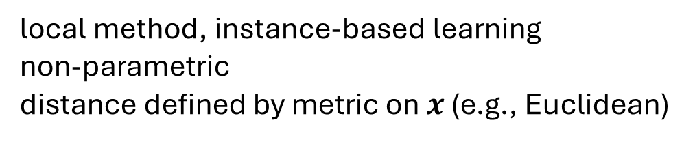
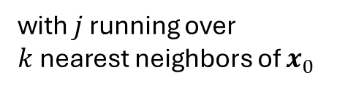

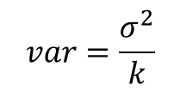
Another Example: k-Nearest Neighbors (kNN)
local method, instance-based learning
non-parametric
distance defined by metric on $x$ (e.g., Euclidean)
regression:
$$\hat{f}\left(x_{0}\right)=\frac{1}{k}\sum_{j=1}^{k}{y_{j}}$$
with $j$ running over $k$nearest neighbors of $x_{0}$
low k: low bias but high variance
high k: low variance but high bias
$$bias=f\left(x\right)− \frac{1}{k}\sum_{j=1}^{k}{y_{j}}$$
$$var=\frac{σ^{2}}{k}$$

Slide 23

Algorithmic Families of Supervised Learning
parametric models
nearest neighbors (local methods, instance-based learning):
non-parametric models
decision trees:
rule learning
linear regression
Day
neural networks: many linear models, non-linear by means of activation functions
Weekday
Weekend
3
Promo
No
Yes
demand prediction
5
8
often used in ensemble methods
bagging: random forests
boosting: gradient boosting
kernel/support-vector machines: linear model (maximum-margin hyperplane) with kernel trick

Slide 24
Common Idea: Learning from Data
ML algorithm + data = explicit algorithm
much better generalizability than handcrafted algorithms
unfortunately, no general best ML algorithm:
need to pick right method for the task at hand

Slide 25
Generalization
core of ML: empirical risk minimization (training error) as proxy for minimizing unknown population risk (test error)
generalization gap: difference between test and training error
curse of dimensionality: typically, many features (dimensions)
→ lots of data needed to densely sample volume

Slide 26
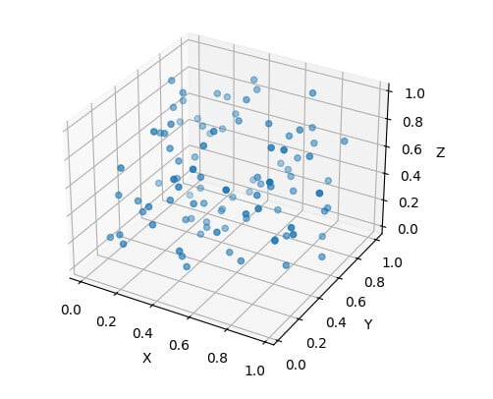
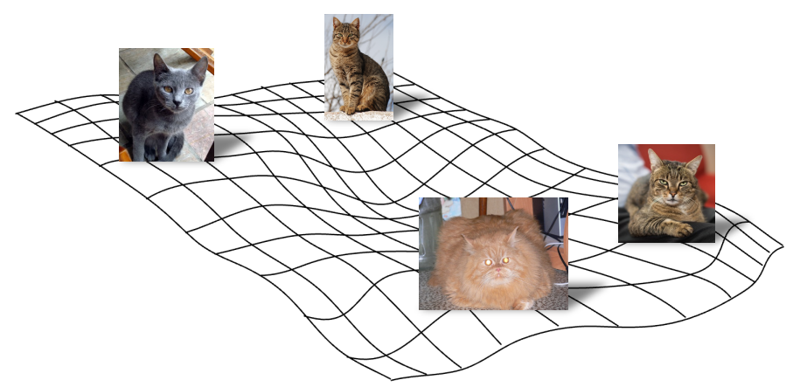
Manifold Hypothesis
luckily, reality is friendly: most high-dimensional data sets reside on lower-dimensional manifolds → enabling effectiveness of ML

